Slide 1

Green University of Bangladesh
Department of Computer Science and Engineering (CSE)
Faculty of Sciences and Engineering
Spring 2024, B.Sc. in CSE (DAY)
Lab Report NO # 03
Course Title: Artificial Intelligence Lab
Course Code: CSE 316 Section: CSE 213 – D1
Problems / Tasks / Domains:
Write a program to perform DFS traversal on a 2D plane by taking the user input of grid size N. After that generate N×N matrix and place the obstacles randomly. Now print the matrix and take user input of starting and goal state, find the path from source to destination using DFS.
Student Details
Name | ID
Md. Shahidul Islam Prodhan | 213902017
Lab Assigned Date: 20th March 2024
Submission Date: 1st April 2024
Course Teacher’s Name: Fairuz Shaiara, Lecturer
[For Teacher’s use only: Don’t write anything inside this box]
Lab Report Status
Marks: | Signature:
Comments: | Date:

Slide 2
1. TITLE OF THE LAB REPORT EXPERIMENT
Implement Depth-First Search.
2. OBJECTIVES/AIM
The primary objectives of this lab is -
To understand how to represent states and nodes in a graph.
To understand how Depth-First Search (DFS) works on a two-dimensional (2D) plane.
3. PROCEDURE / ANALYSIS / DESIGN
Problem Description:
The task at hand involves implementing a Depth-First Search (DFS) algorithm to find a path from a given source node to a target node in a two-dimensional grid environment. The grid consists of cells that can either be open spaces or obstacles, where movement is only allowed through open spaces.
Main Objectives
Pathfinding: Find a path from a specified source cell to a target cell in the grid.
Grid Generation: Randomly generate a grid with obstacles and open spaces.
User Interaction: Prompt the user to input the coordinates of the source and target cells.
Output Visualization: Display the generated grid and the path found from the source to the target.
Brief overview of the code
It defines a Node class to represent nodes in the grid, with attributes for x and y coordinates, and depth.
It defines a DFS class with methods for initializing the search, generating a random grid, printing directions, and performing the DFS search.
The generate_grid() method randomly generates a grid of 0s and 1s, where 0 represents an obstacle and 1 represents an open space.
The init() method initializes the search by taking user input for the source and goal coordinates, generates the grid, and initiates the DFS search.
The st_dfs() method performs the depth-first search recursively, exploring neighboring nodes in four directions (up, down, left, right) until it finds the goal or exhausts all possibilities.
The main() function creates an instance of the DFS class and initiates the search.

Slide 3
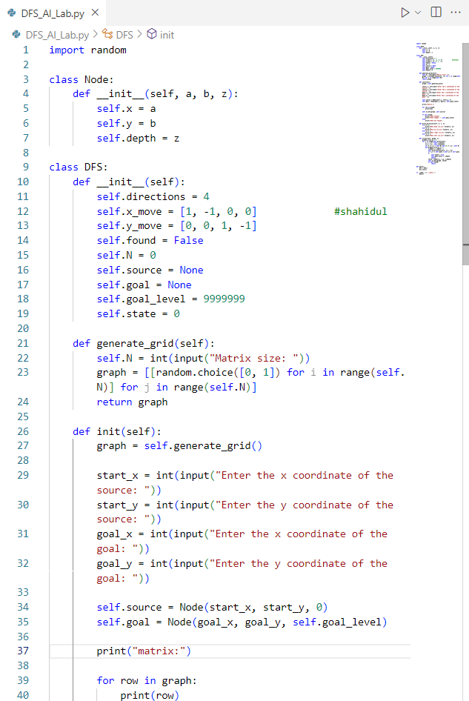
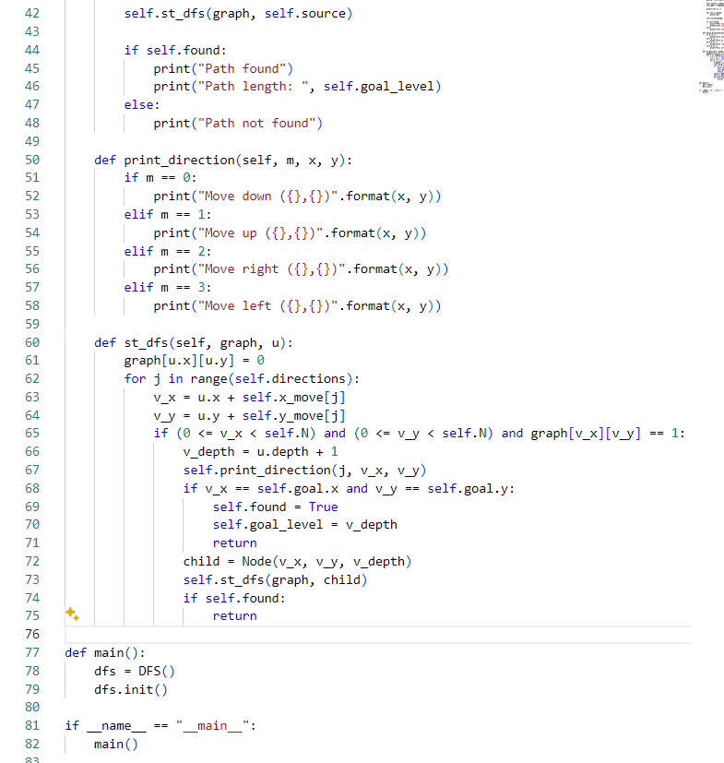
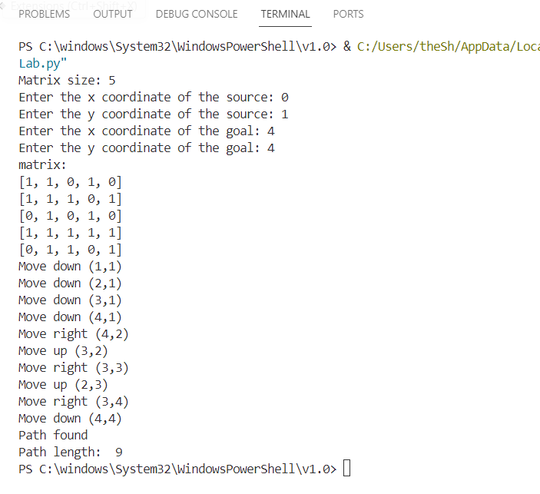
4. IMPLEMENTATION
5. TEST RESULT / OUTPUT

Slide 4
6. ANALYSIS AND DISCUSSION
The lab report explored the implementation of the depth-first search (DFS) algorithm for pathfinding in a grid environment. Key points and learning outcomes include:
Understanding the concept of DFS and its application in graph traversal.
Designing and implementing a recursive DFS algorithm to navigate through obstacles in a grid.
Analyzing the strengths and weaknesses of DFS, including its simplicity in implementation and potential scalability issues.
Highlighting the importance of considering the underlying principles and design choices when utilizing DFS for pathfinding tasks.
One notable aspect of DFS is its simplicity in implementation, thanks to the recursive approach. However, this simplicity comes with potential drawbacks, such as the risk of encountering infinite loops in cyclic graphs or reaching stack overflow with deep recursion in large grids.
Despite its limitations, DFS remains a valuable tool for pathfinding, especially in scenarios where memory consumption is a concern or when the grid is relatively small. By understanding its underlying principles and considering its strengths and weaknesses, we can leverage DFS effectively in various applications, from maze-solving algorithms to network traversal in computer science.
7. SUMMARY
In conclusion, The Depth-First Search (DFS) algorithm implemented in this lab report offers an efficient solution for pathfinding in a grid environment. By systematically exploring neighboring nodes, DFS can navigate through obstacles to find a path from the source to the goal.
Overall, the lab report provided valuable insights into the practical application of DFS and its significance in solving real-world problems. By applying the knowledge gained from this exercise, one can better appreciate the versatility and effectiveness of DFS in various domains of computer science and beyond.

